Slide 1
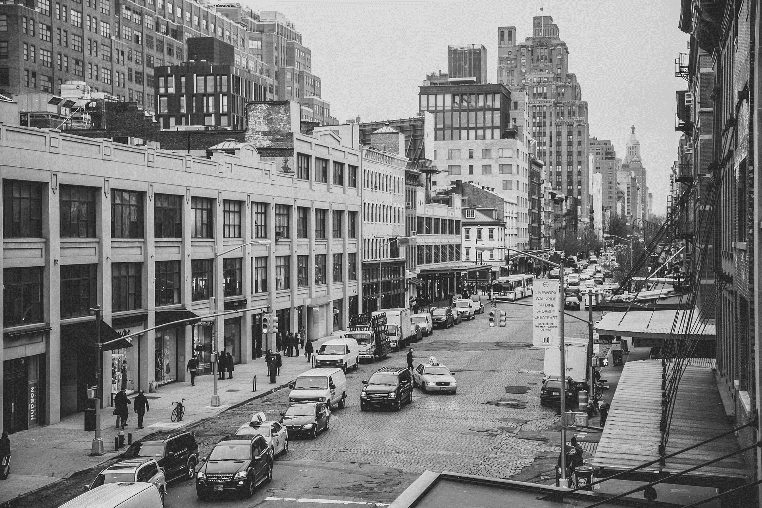
AMAZING
LISTEN TO
PHOTO
ENGINEERING
OF
BIG DATA
WENBO SUN 001994516
JIANAN WEN 001678266
YIPENG HONG 001228971
KAIYING ZHANG 001222657

Slide 2


CHANGE
Do you ever feel confused about what kind of songs you want to hear?
Do you want to know what photos want to told?
Do you want to listen the history about one city?
Do you want to know the story of one place?
Pick up your phone!
Turn on the camera！
Upload the photo!
JUST LISTEN!
THE
WORLD
Music
AND
LIFE
Image

Slide 3

Enjoy the
Music now
SHOW TIME

Slide 4
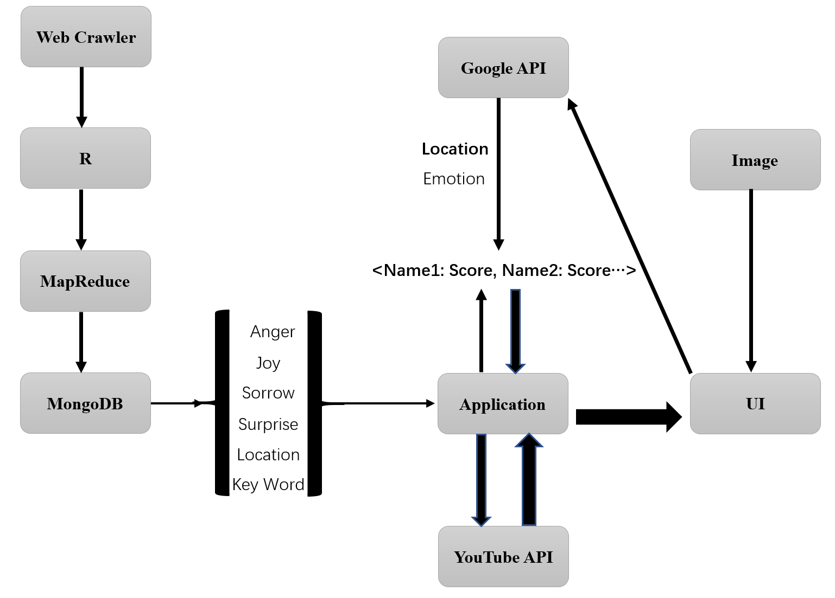

Slide 5
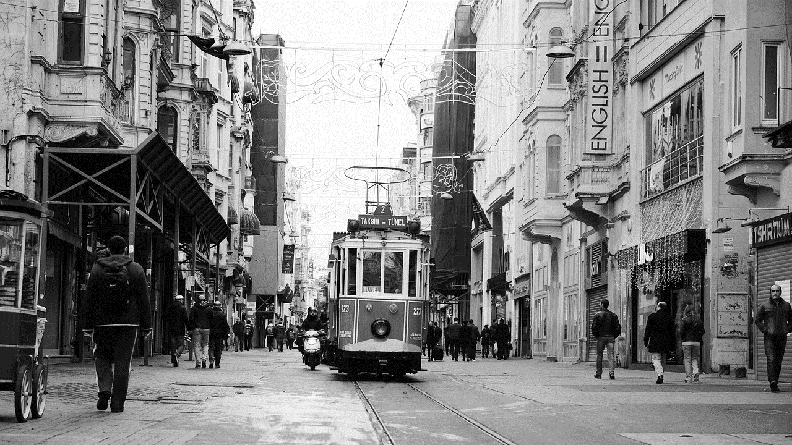
Photo analyze
Score & Weights
Location
Emotion
Keyword
Sentiment
connections between emotions of image and emotions of song
connections between keyword of image and keywords of songs
Select songs by the color tone(RGB) of the image and sentiment of song
Find songs about the location
90%
80%
50%
20%

Slide 6
1
DATA MINING
Get data
Clean data
Analyze data
Take photo
->
Enjoy music
2
DATA ANALYSE
Reformat data
Classify songs
3
CONSTRUCTION
Photo analysis
Build Database
Grade Songs
4
USERINTERFACE
Connect to YouTube API
Demonstrate result
5
TEST
Calculate accuracy
Test website

Slide 7
PHYTHON
&
XPath of HTML

Slide 8
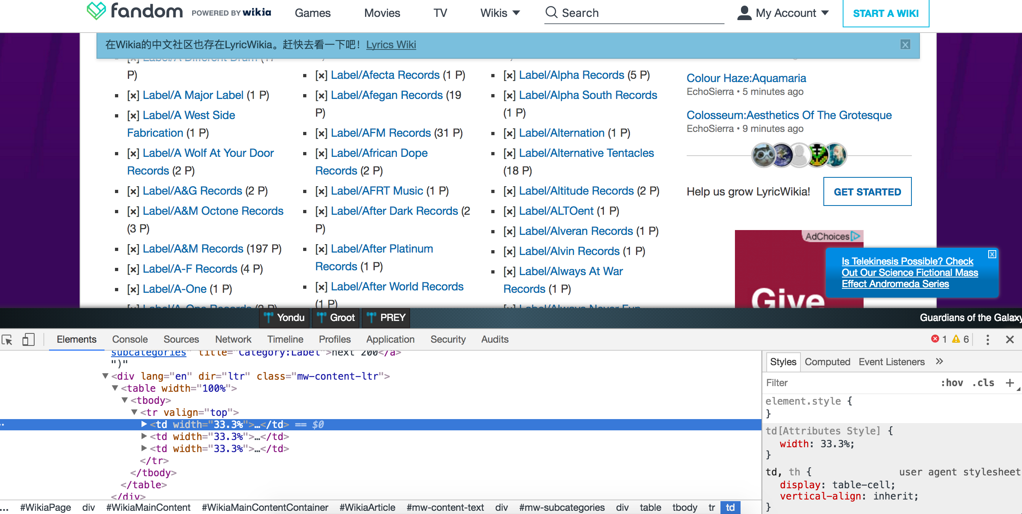
Find Resource
First Step

Slide 9
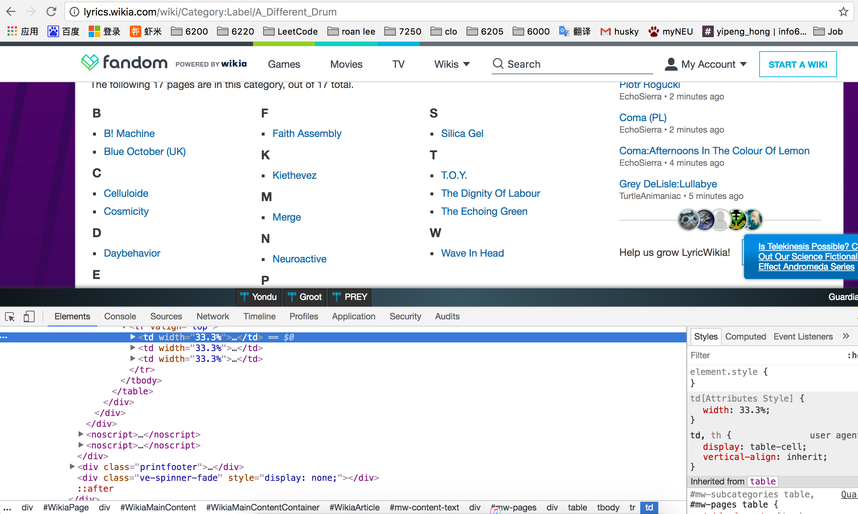
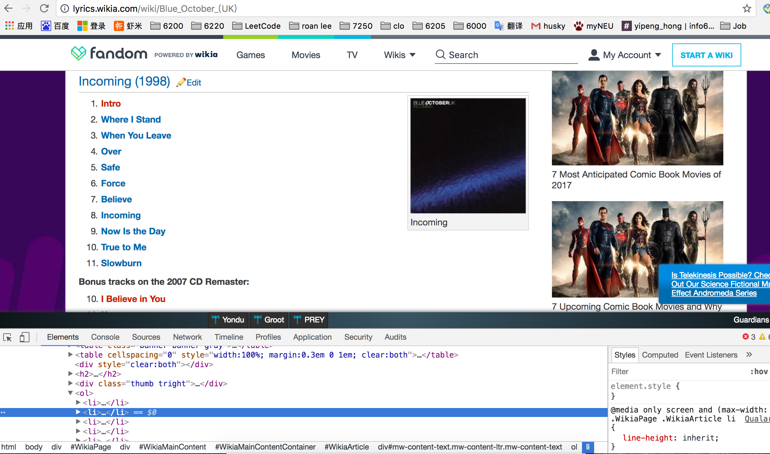
Find Rosource
First Step

Slide 10
DATA
One million songs
1.13 G
Arstist&Name&Lyrics
70%
Clean data

Slide 11
1
DATA MINING
Get data
Clean data
Analyze data
Take photo
->
Enjoy music
2
DATA ANALYSE
Reformat data
Classify songs
3
CONSTRUCTION
Photo analysis
Build Database
Grade Songs
4
USERINTERFACE
Connect to YouTube API
Demonstrate result
5
TEST
Calculate accuracy
Test website

Slide 12
R
&
MapReduce

Slide 13
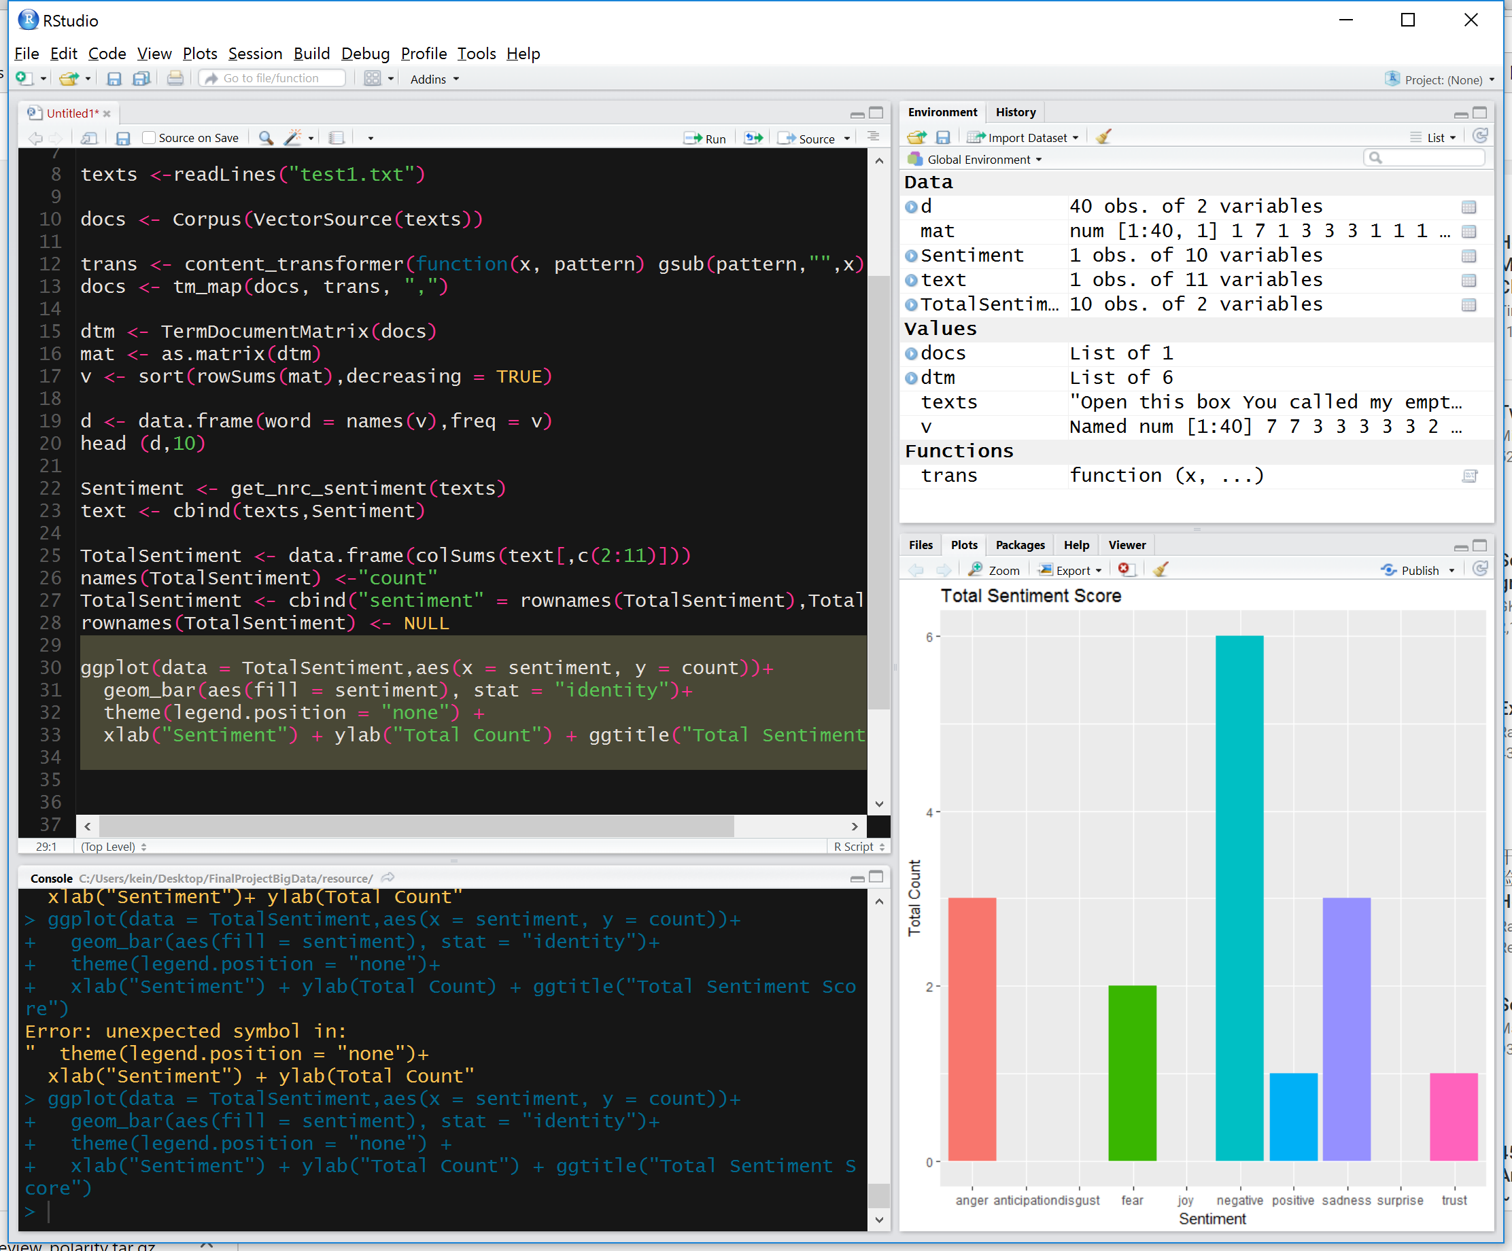
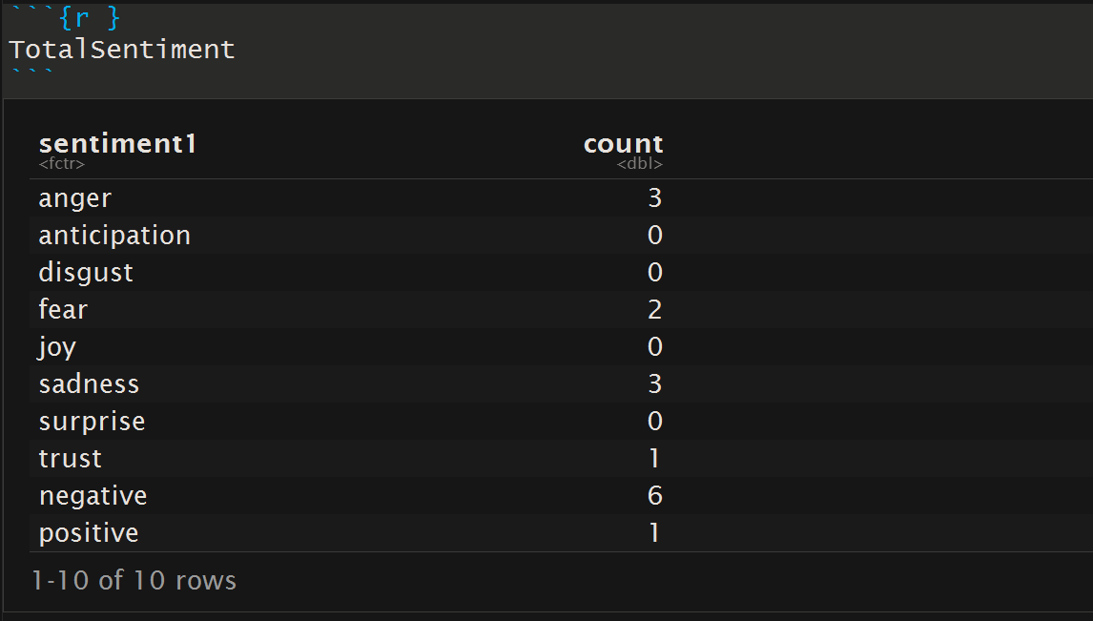
Sentiment Analyses
Second Step

Slide 14
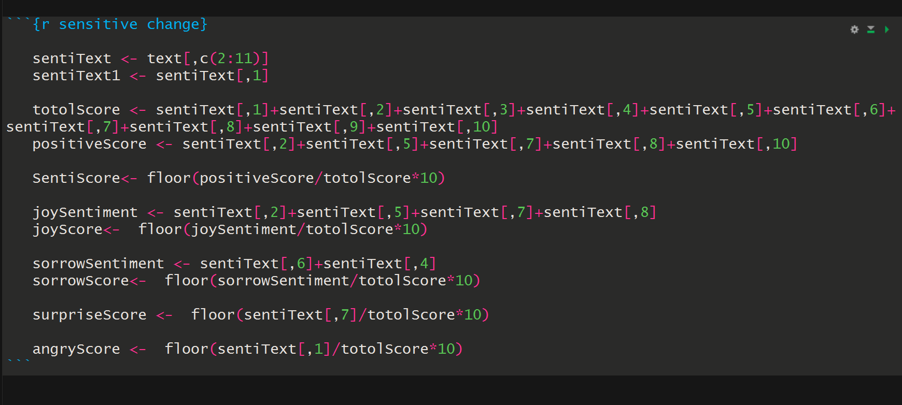
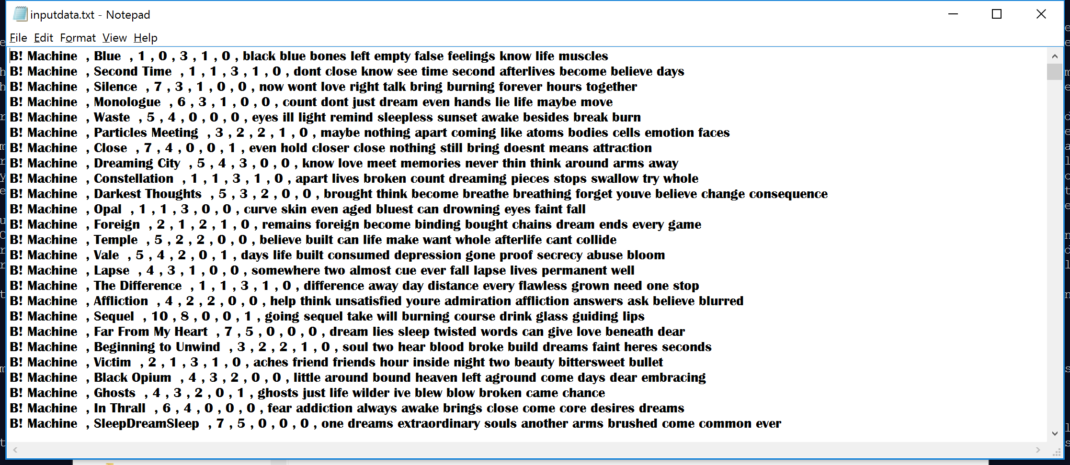
Calculate Score of sentiments
Second Step

Slide 15
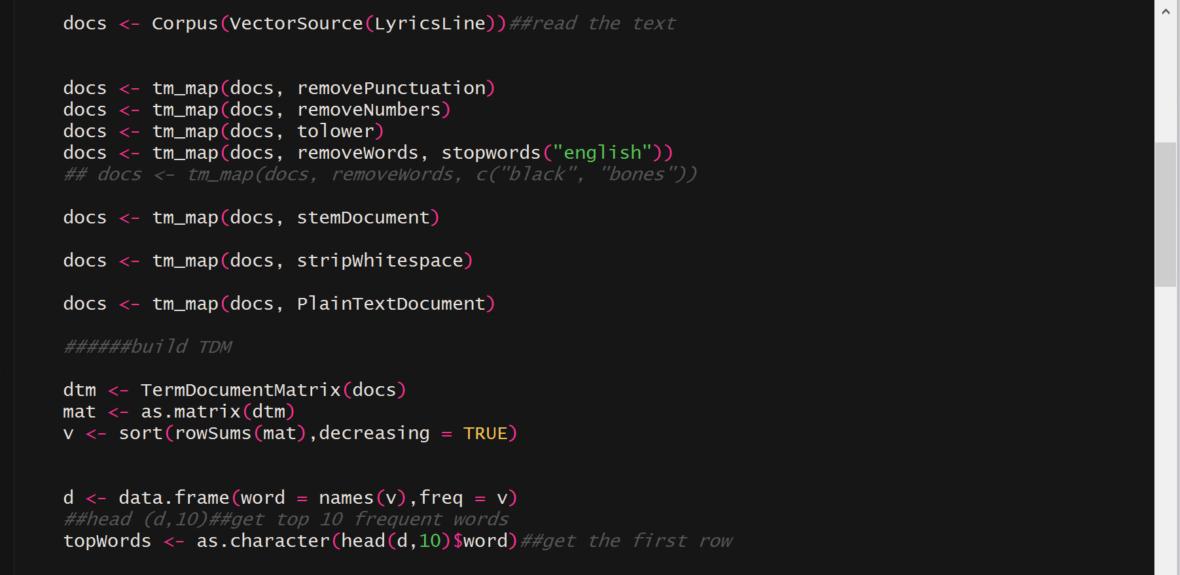
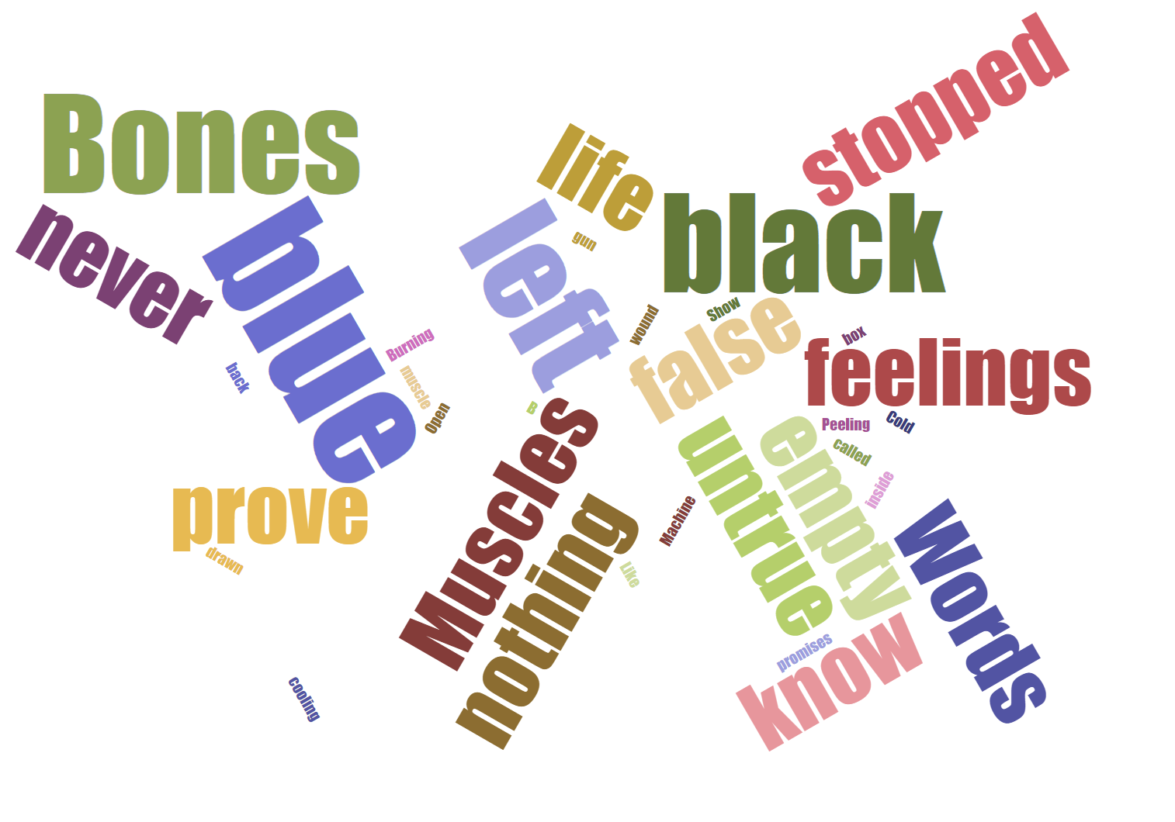
Find Keywords
Second Step

Slide 16
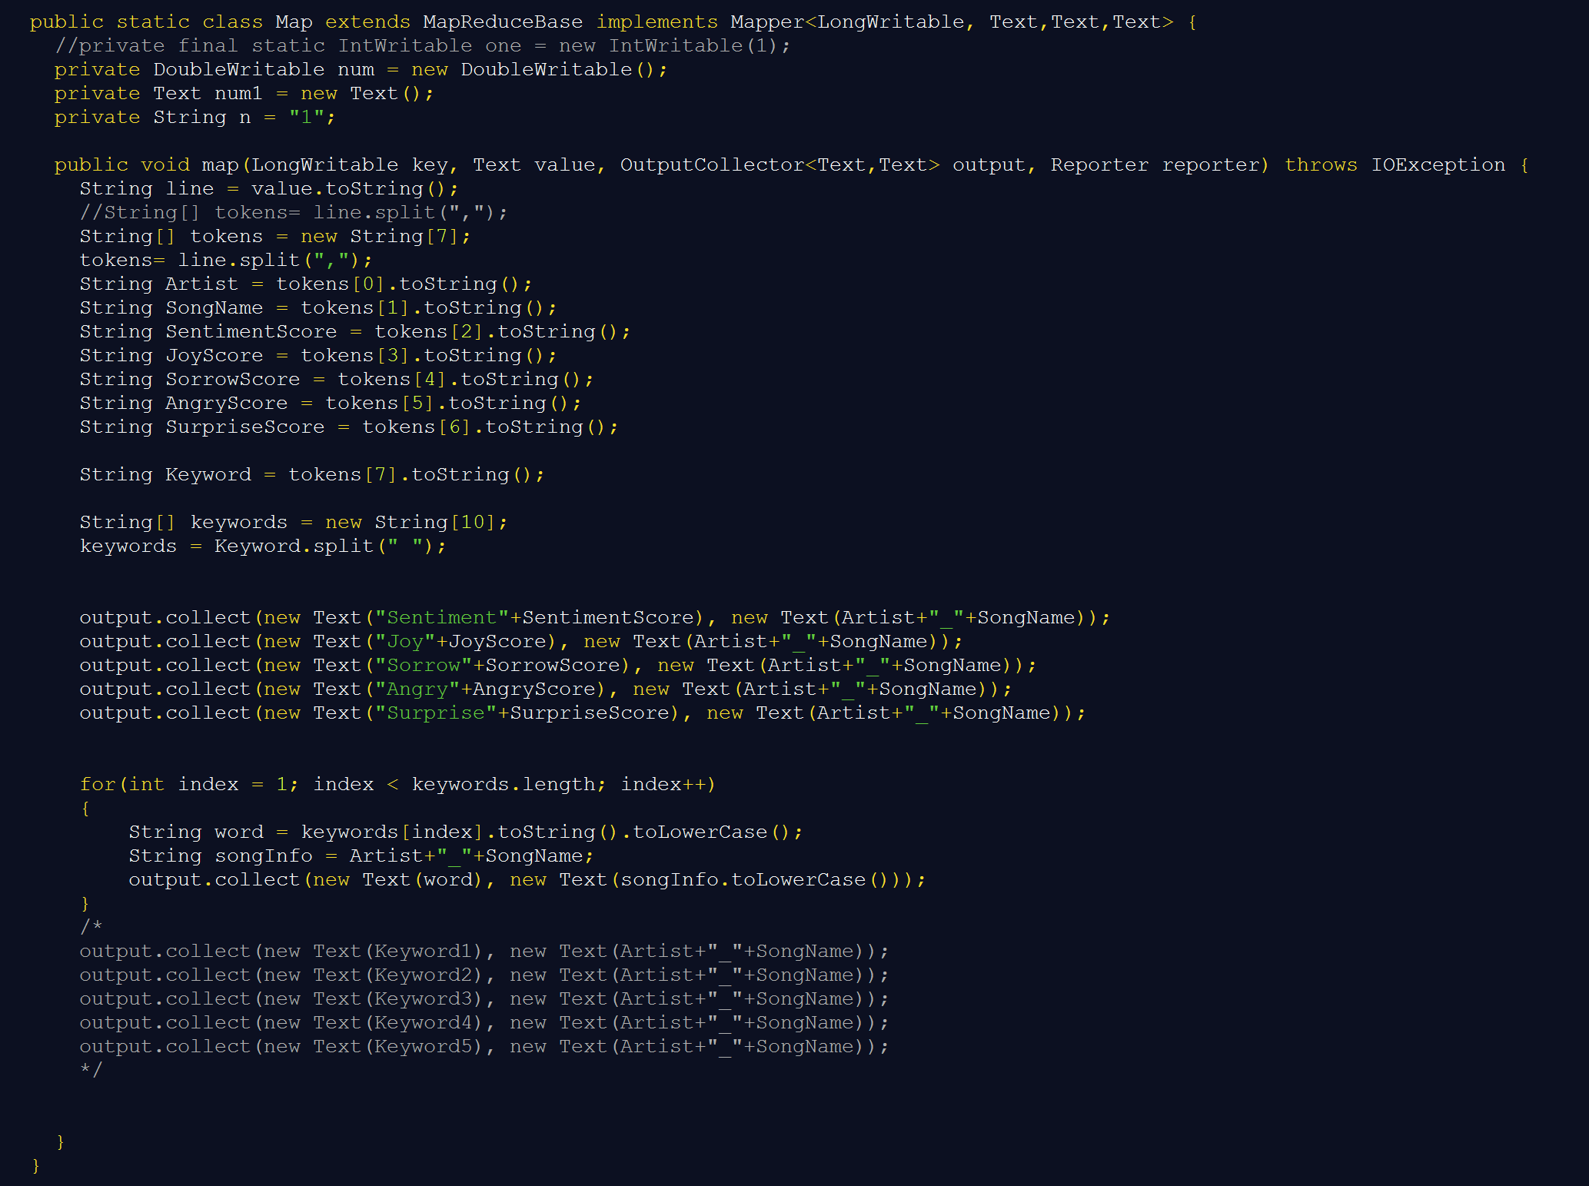
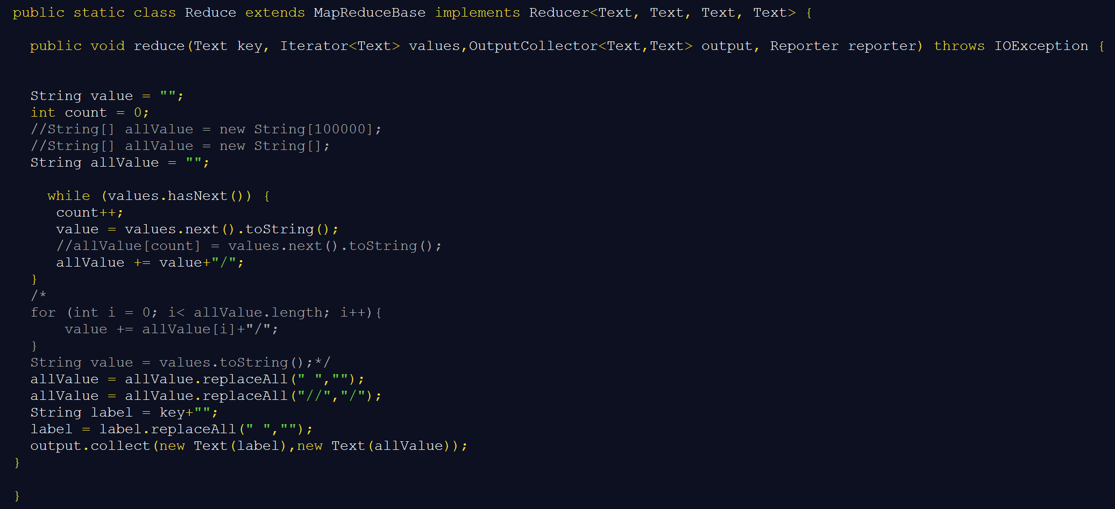
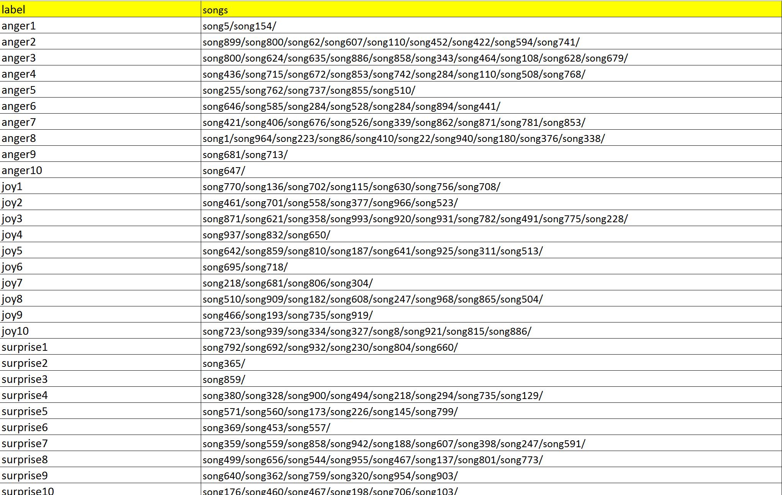
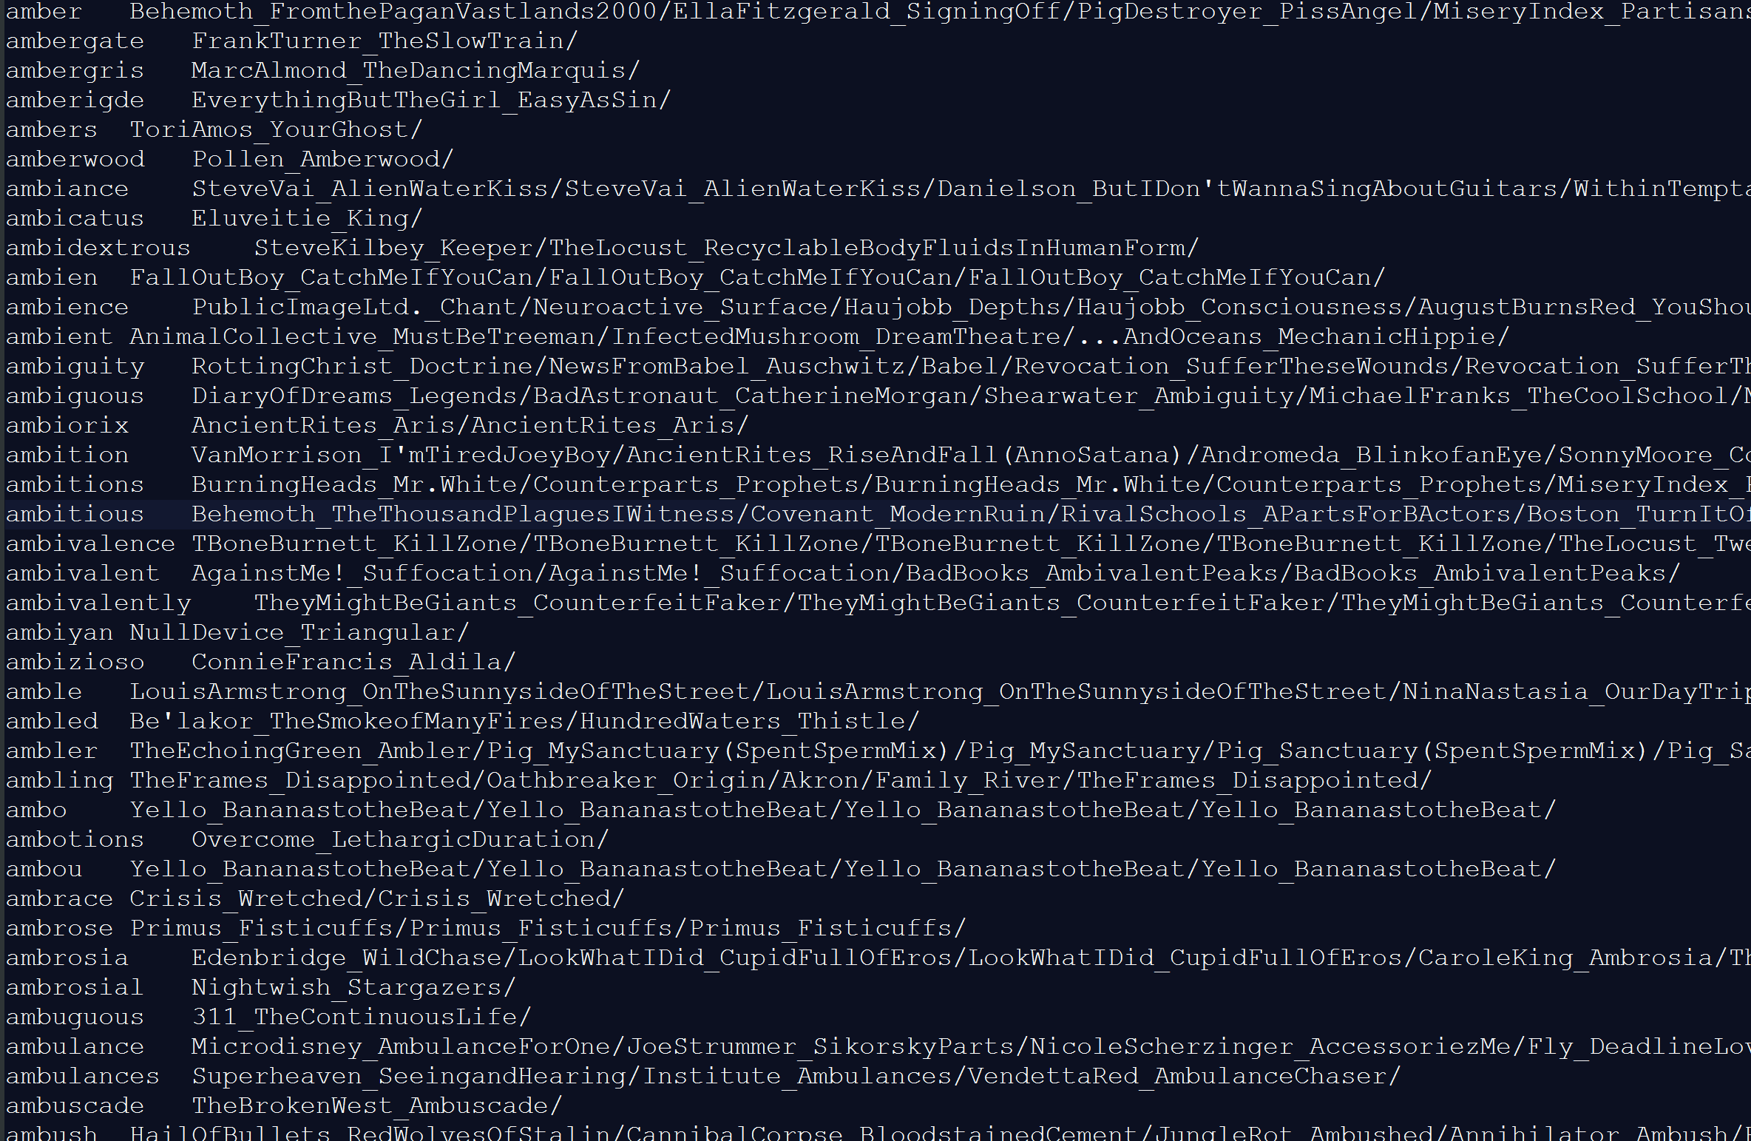
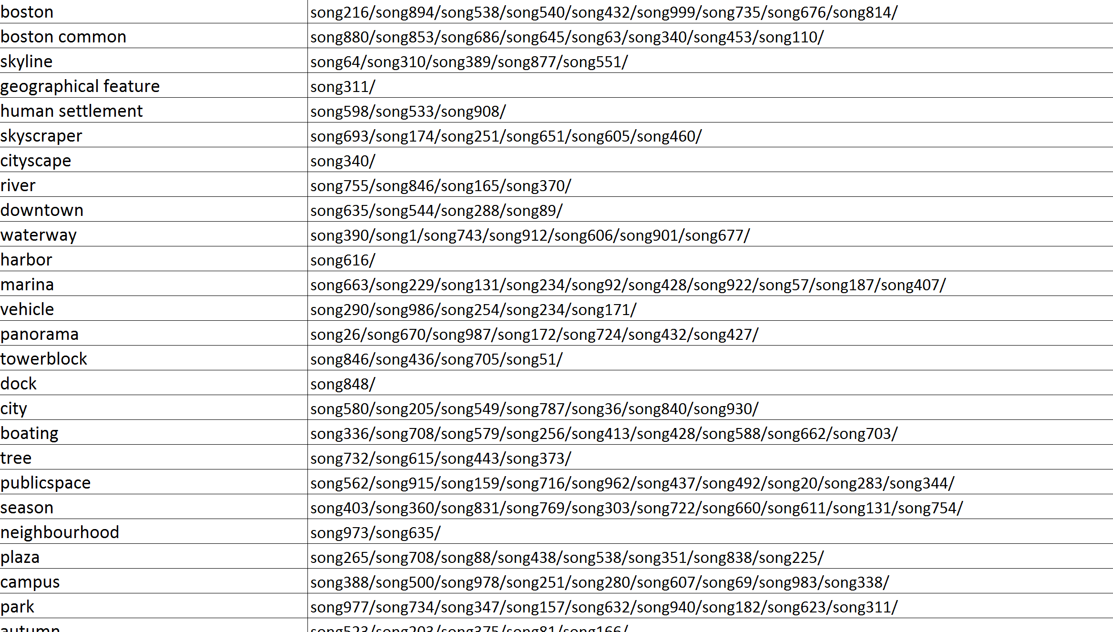
Reformat - MapReduce
Second Step

Slide 17
1
DATA MINING
Get data
Clean data
Analyze data
Take photo
->
Enjoy music
2
DATA ANALYSE
Reformat data
Classify songs
3
CONSTRUCTION
Photo analysis
Build Database
Grade Songs
4
USERINTERFACE
Connect to YouTube API
Demonstrate result
5
TEST
Calculate accuracy
Test website

Slide 18
Eclipse
&
Mango DB

Slide 19
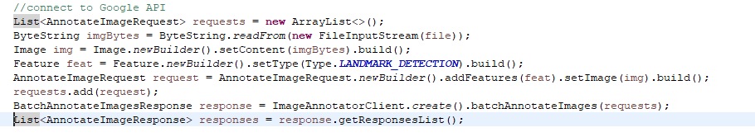
First Step
Connect with google cloud vision

Slide 20
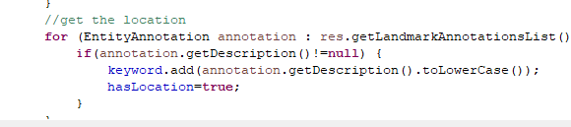
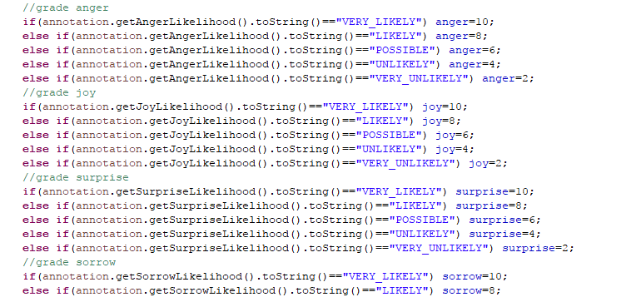
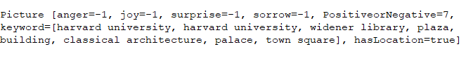
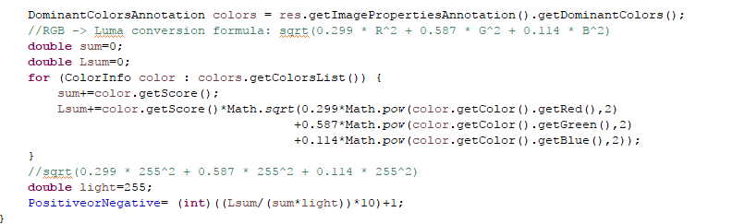
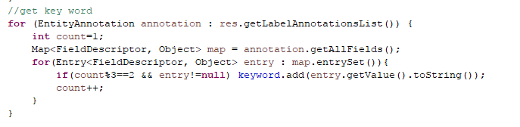
Information filter
1
Second Step
2
3
4

Slide 21
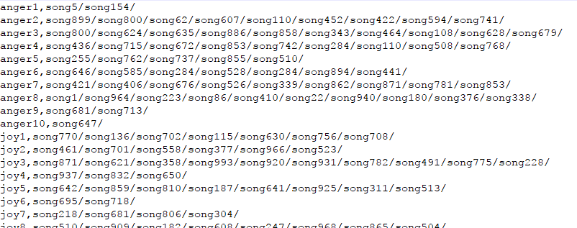
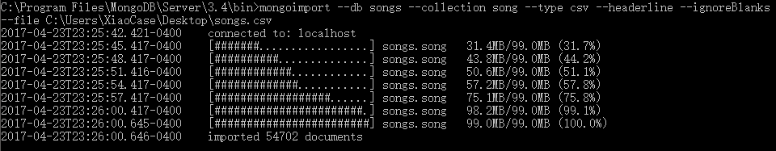
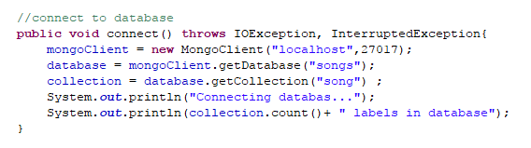
Build Database
Third Step

Slide 22
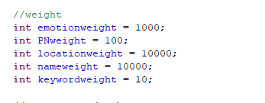
Grade Song
Forth Step
Search for songs which with location information “boston”
Search for songs which grade is joy6
Song List
SONG 1
SONG 2
SONG 2
SONG 3
SONG 4
Score
1000
1000
10000
10000
10000

Slide 23
1
DATA MINING
Get data
Clean data
Analyze data
Take photo
->
Enjoy music
2
DATA ANALYSE
Reformat data
Classify songs
3
CONSTRUCTION
Photo analysis
Build Database
Grade Songs
4
USERINTERFACE
Connect to YouTube API
Demonstrate result
5
TEST
Calculate accuracy
Test website

Slide 24
JAVA
&
SERVLET

Slide 25
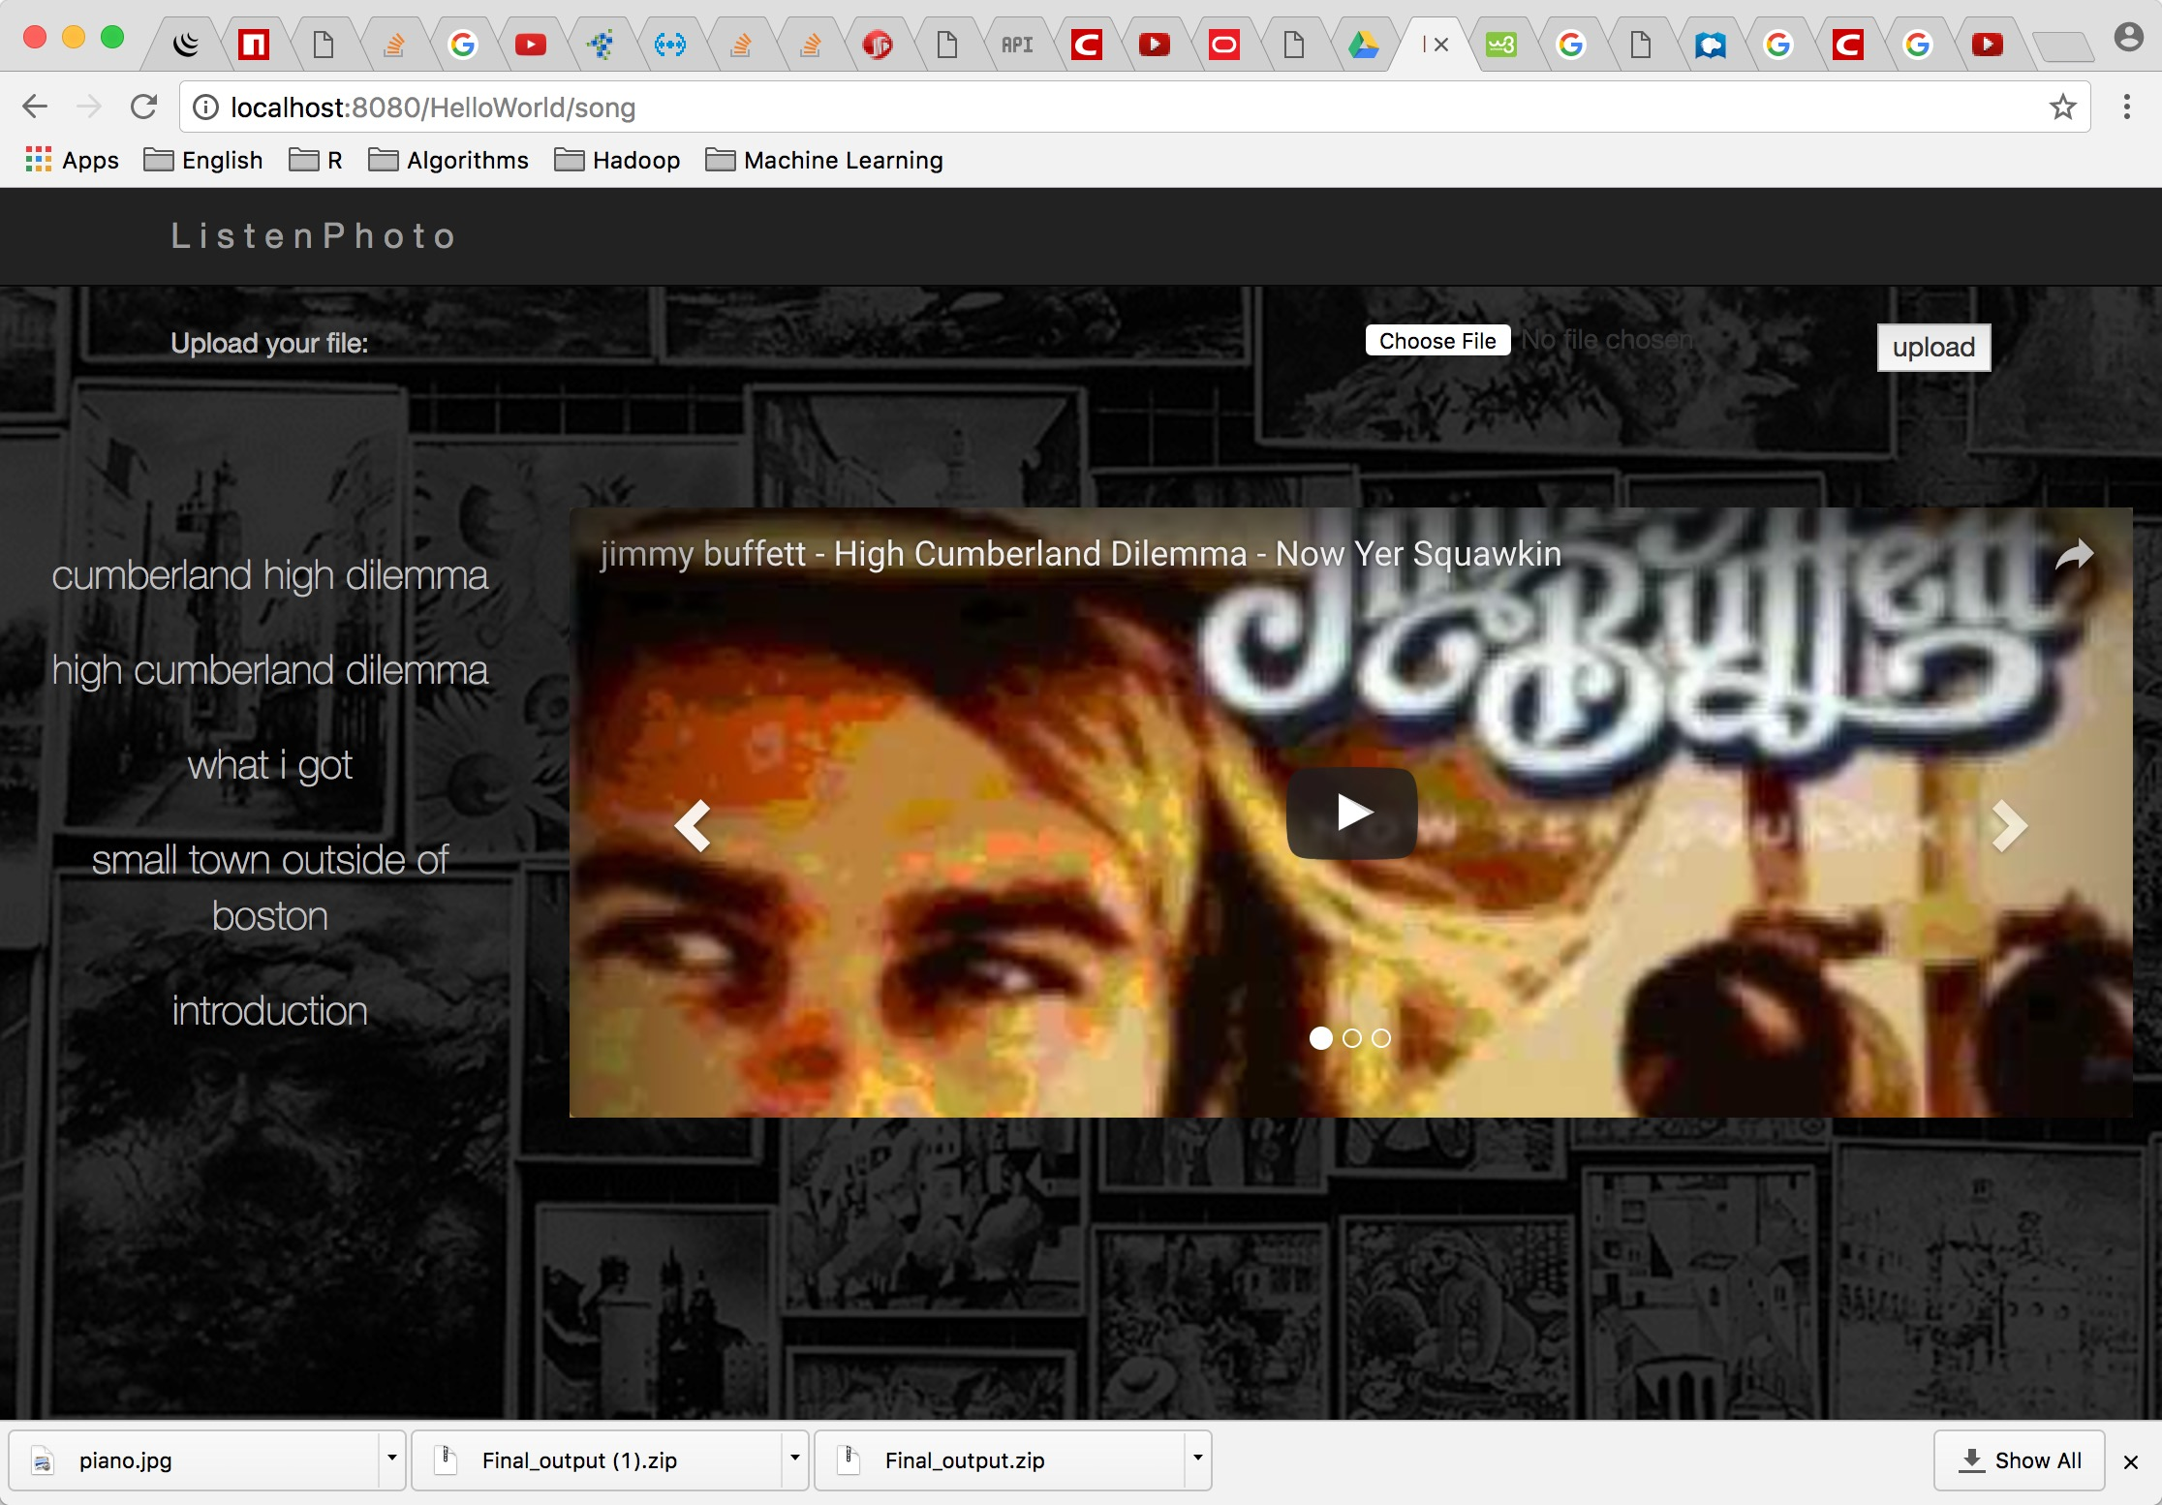
USERINTERFACE

Slide 26
1
DATA MINING
Get data
Clean data
Analyze data
Take photo
->
Enjoy music
2
DATA ANALYSE
Reformat data
Classify songs
3
CONSTRUCTION
Photo analysis
Build Database
Grade Songs
4
USERINTERFACE
Connect to YouTube API
Demonstrate result
5
TEST
Calculate accuracy
Test website

Slide 27
85%
EMOTION
&
Content
ACCURACY
80%
PLACE
ACCURACY
(depend on API)
B
2

Slide 28
THANKS

